Slide 1
Sunfish Lake Park Buckthorn Removal Progress
Presentation to Lake Elmo Parks Commission October 20, 2025
Larissa Mottl, Stantec, Project Manager

Slide 2
Phases of the Sunfish Lake Park Restoration Project
Funded by: Mn Department of Natural Resources, Conservation Legacy Partners program
Phase 1, 40 acres, $154K Completed
Phase 2, 140 acres, $457K Ends 6/2026
Phase 3, $50K, completion ?/2026
Seeking further funding

Slide 3
Remaining Phase 2 Scope
Invasive brush treatments
80 acres of foliar spot spray in woody removal areas
Winter fuelwood reduction
Additional limited forestry mowing & down dead wood pile/burn with snow
Prescribed burns (up to 4 units)
Herbaceous weed control
Burdock, garlic mustard, Canada thistle
33-47 acres
Cut/stump treatment (volunteers, Stantec)
Buckthorn, honeysuckle, barberry, burning bush, roundleaf bittersweet, white poplar

Slide 4
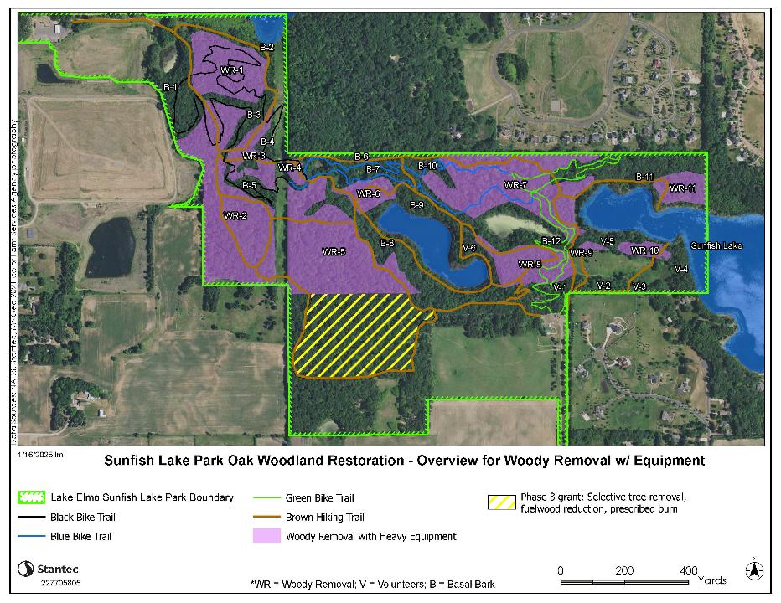
Fuelwood reduction (forestry mow; pile/burn)
Weed spot treat (trails, burn piles)
Brush foliar spray (purple areas)
Brush cut/treat/pile (volunteers)

Slide 5
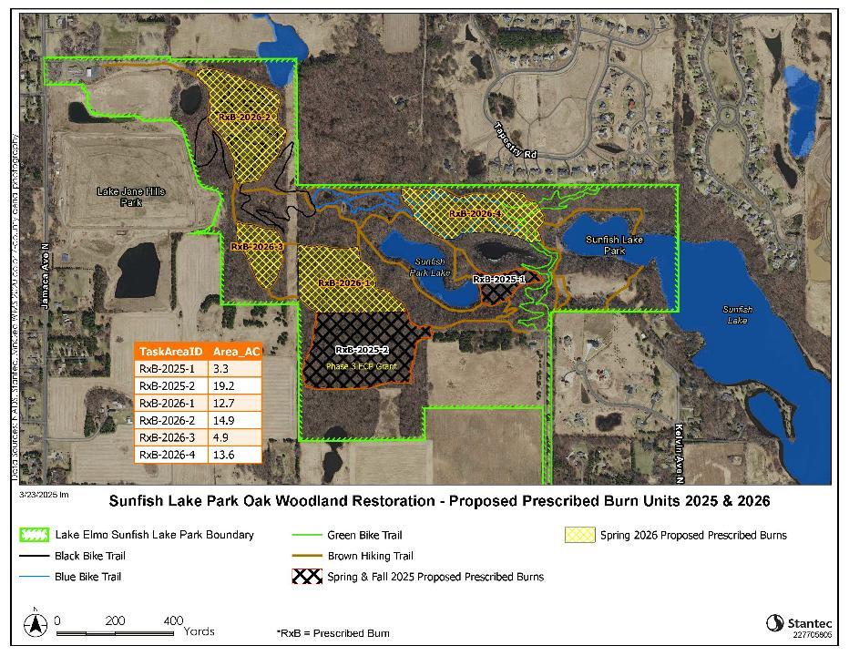
Spr 2026
Spr 2026
Spr 2026
Spr 2026
Phase 3 Grant - Controlled burn (19 ac), this fall or next spring

Slide 6
Photopoint – view North

Slide 7
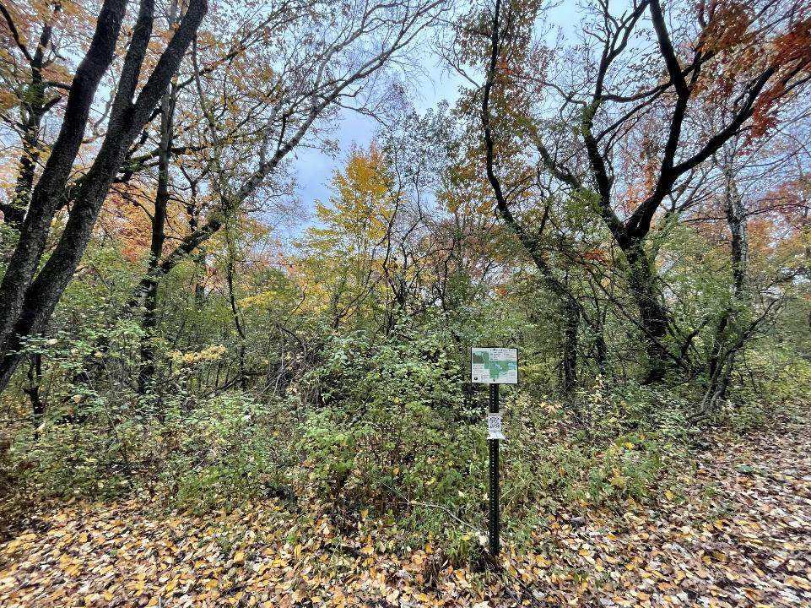
Oct 25, 2023

Slide 8
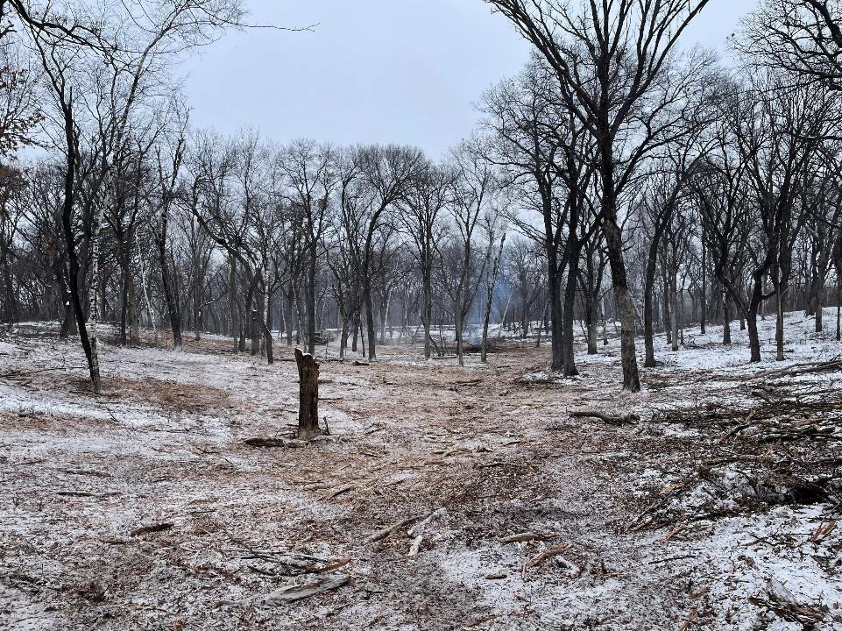
Feb 12, 2025

Slide 9
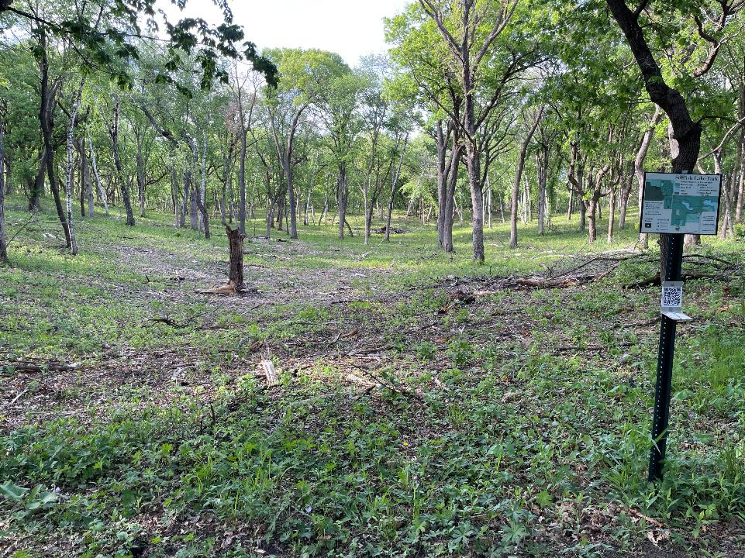
May 10, 2025

Slide 10
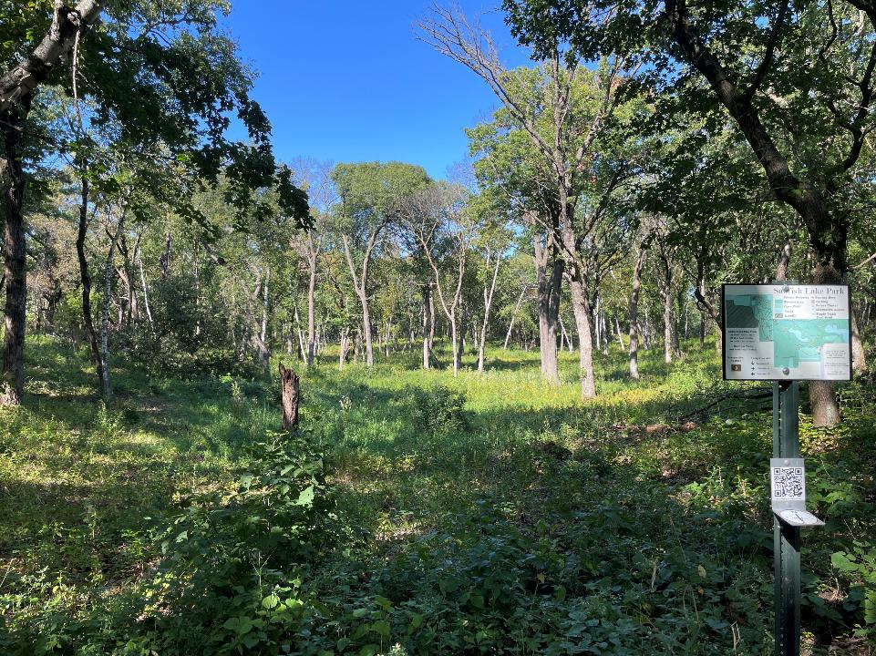
Sept 23, 2025

Slide 11
Photopoint – view East

Slide 12
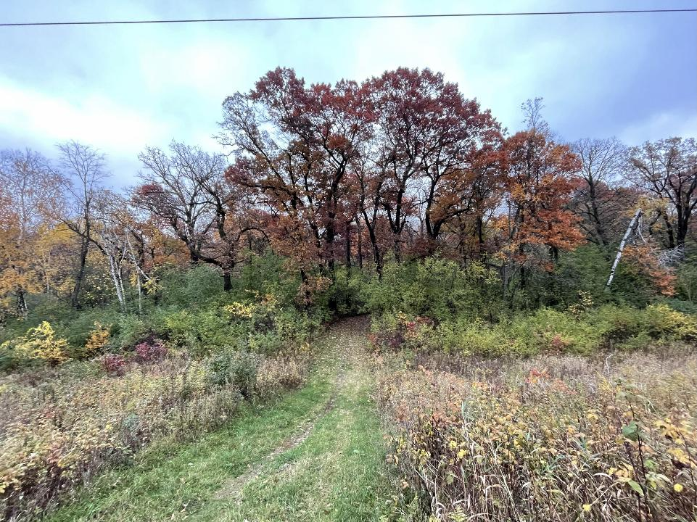
Oct 25, 2023

Slide 13
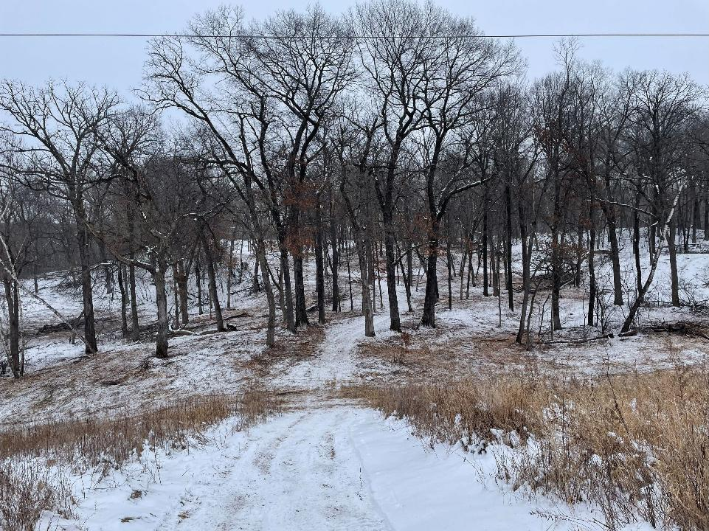
Feb 12, 2025

Slide 14
Photopoint – view West

Slide 15
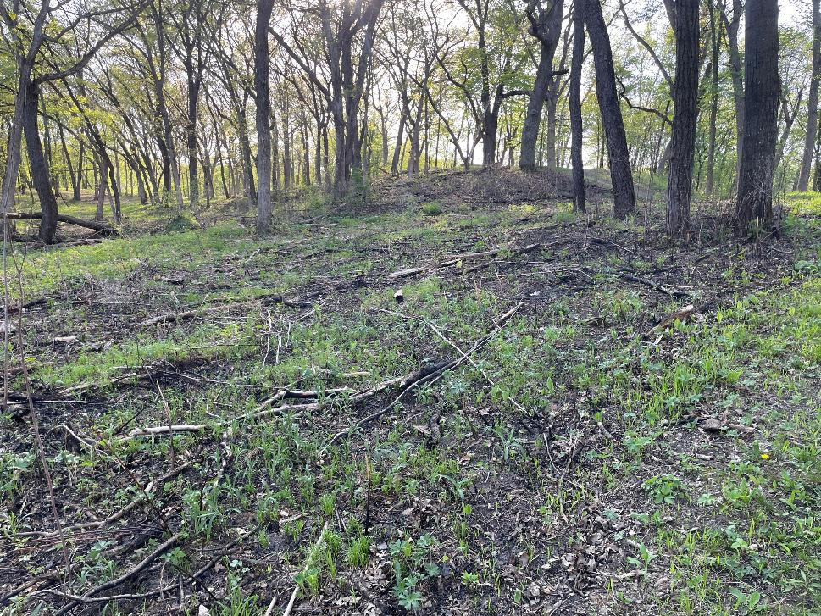
May 2025 – green up after April 23 burn

Slide 16
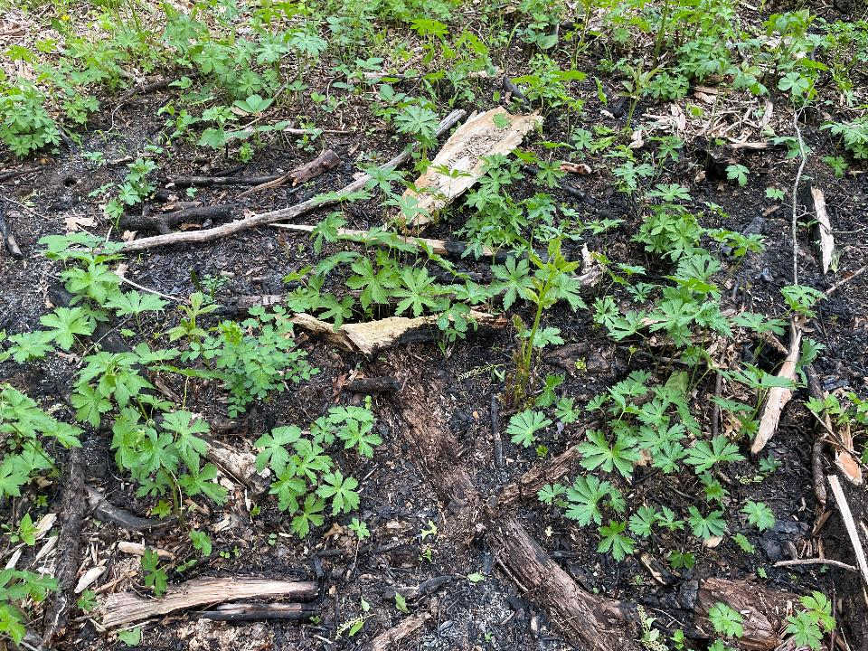
May 18, 2025 – green up after April 23 burn

Slide 17
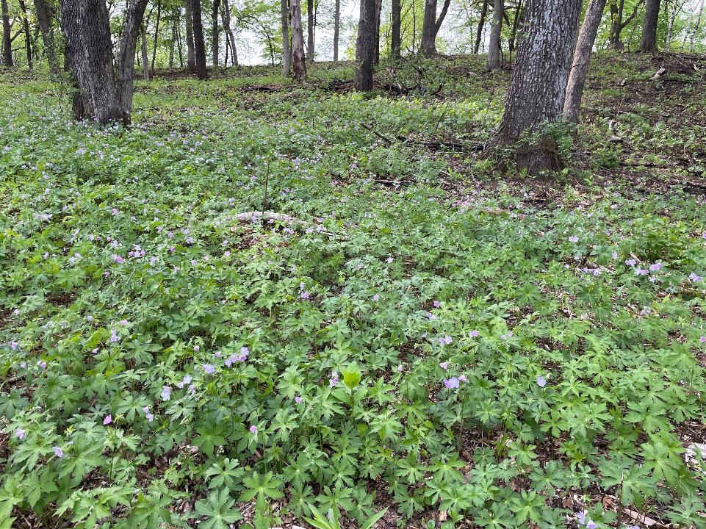
May 18, 2025 – wild geranium blooms

Slide 18
Photopoint – view West

Slide 19
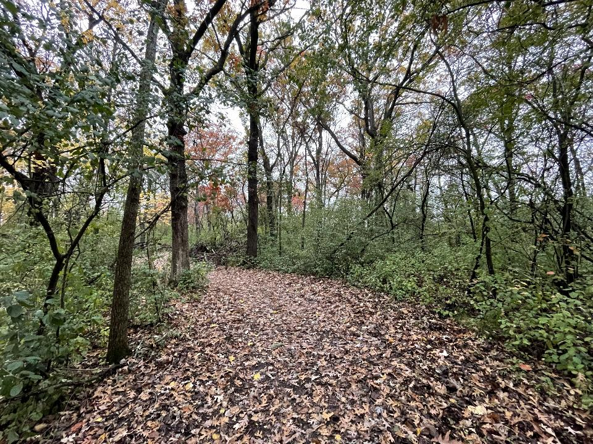
Oct 25, 2023 – before restoration

Slide 20
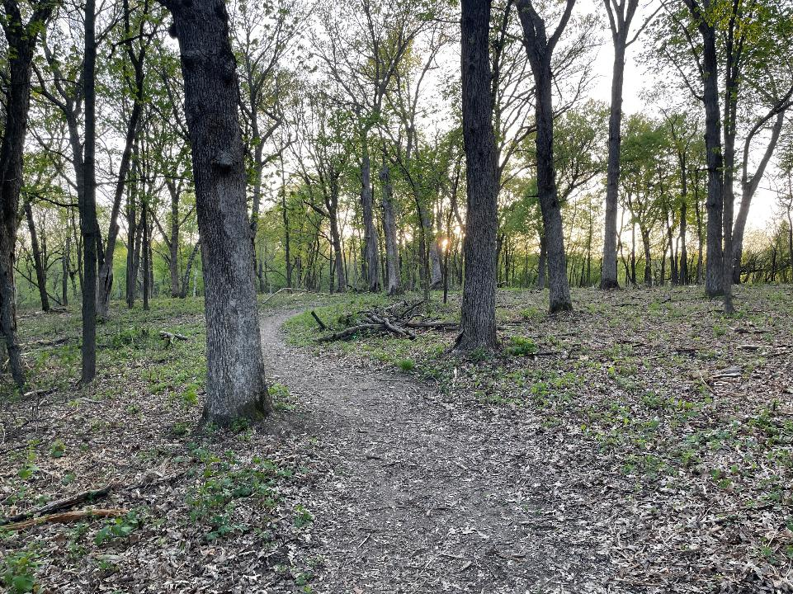
May 2025 – green up after woody removal and forestry mow

Slide 21
Photopoint – view East

Slide 22
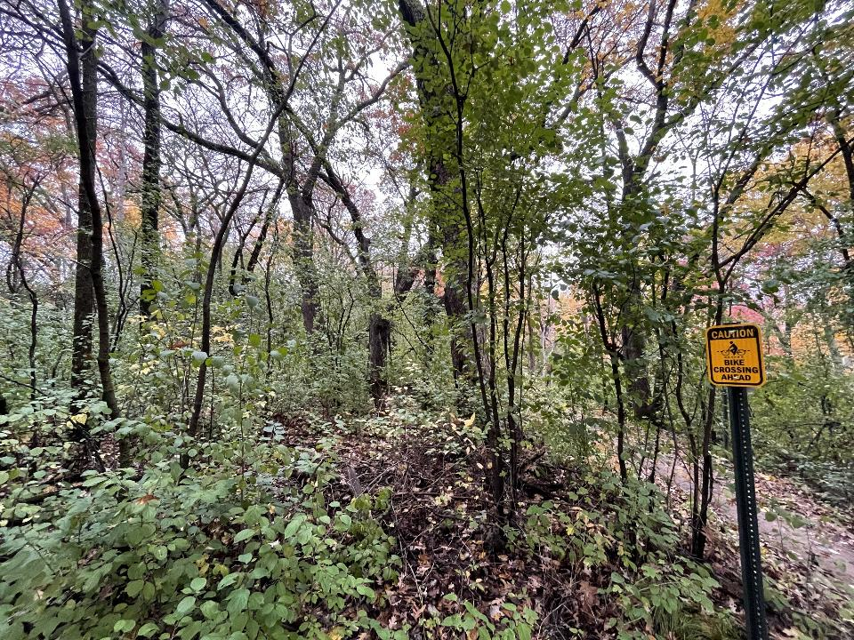
Oct 25, 2023 – before restoration

Slide 23
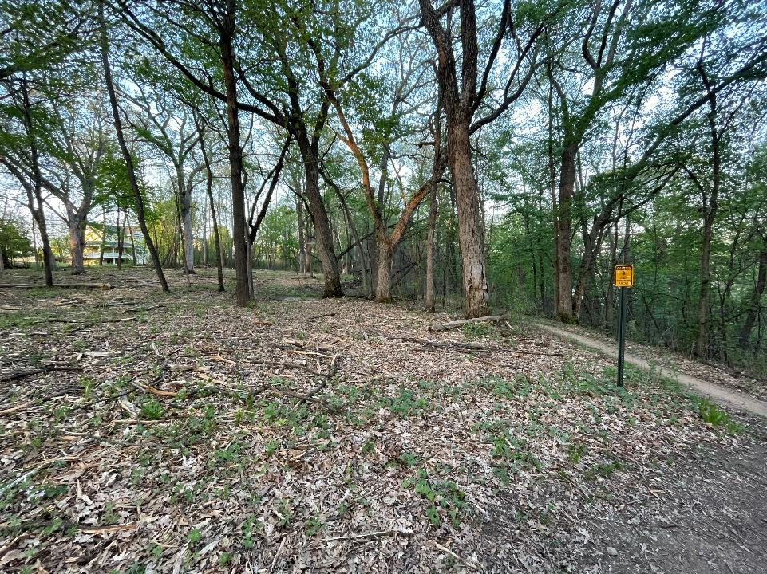
May 2025 – green up after woody removal and forestry mow

Slide 24
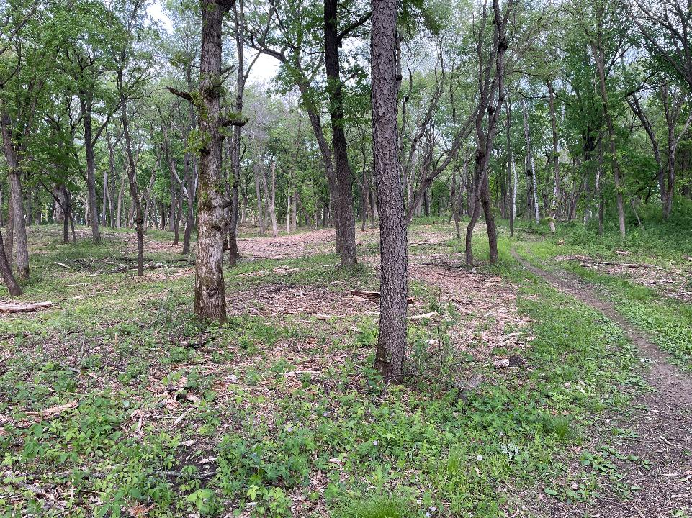
May 18, 2025 – after selective tree & down dead wood removal & forestry mow

Slide 25
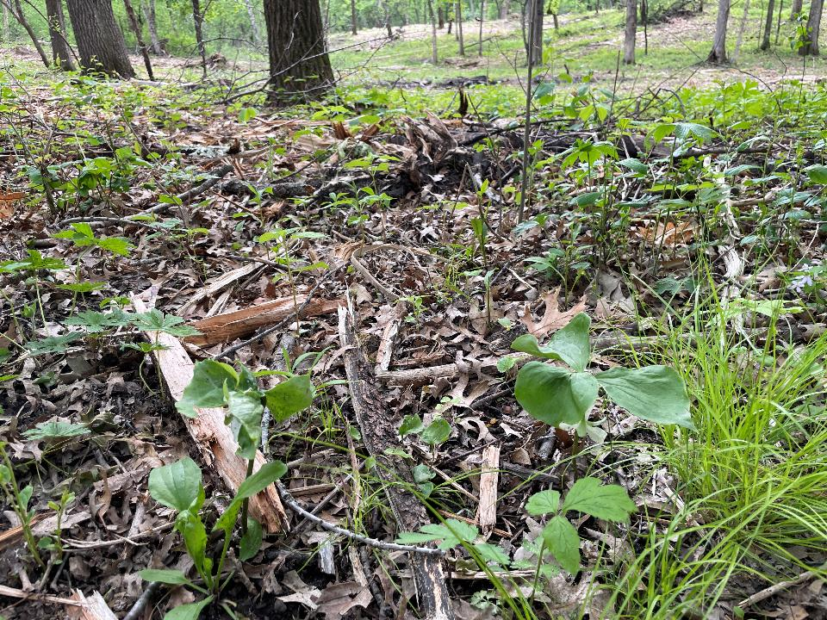
May 26, 2025 – Nodding trillium

Slide 26
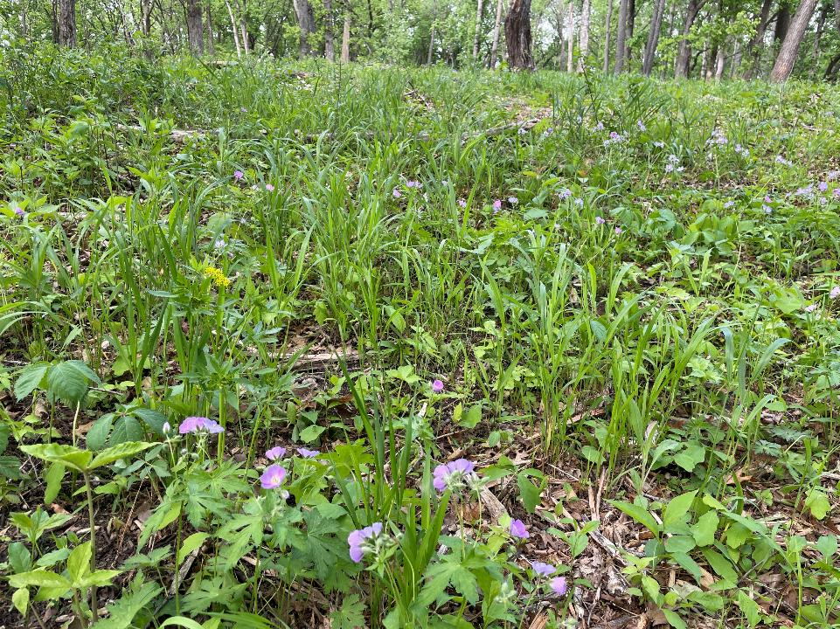
May 18, 2025 Phase 1

